Slide 1


Gaston Residential Services
Sponsors

Slide 2

Ace of Sponsors
Gaston Residential Services
Viva Las Vegas 2025

Slide 3
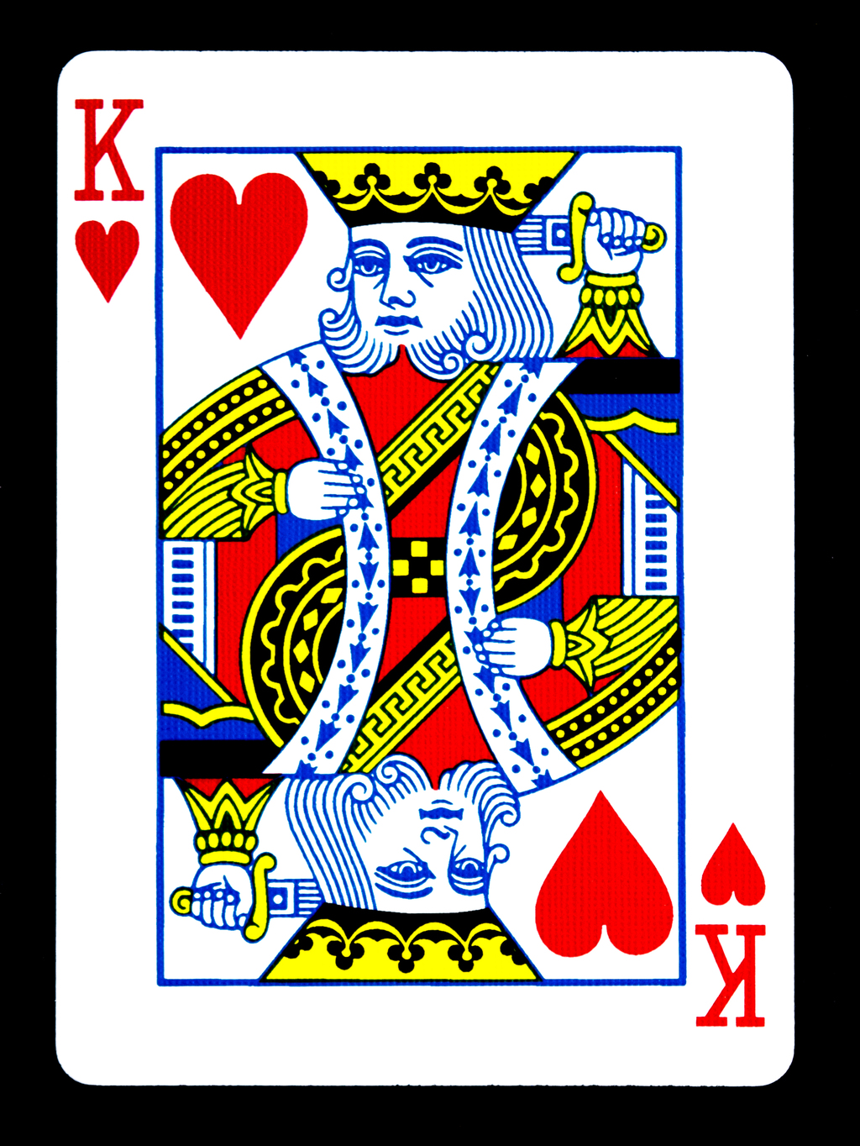
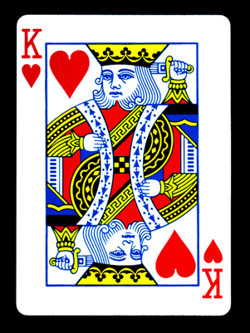




Kings of Sponsors
Gaston Residential Services
Viva Las Vegas 2025

Slide 4


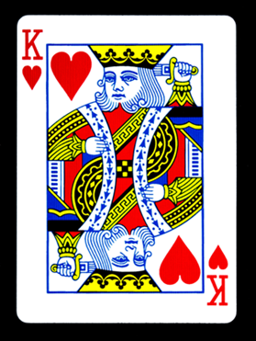

Kings of Sponsors
Gaston Residential Services
Viva Las Vegas 2025

Slide 5









Queen of Sponsors
Loretta Horne
Gaston Residential Services
Viva Las Vegas 2025

Slide 6





Queen of Sponsors

Slide 7
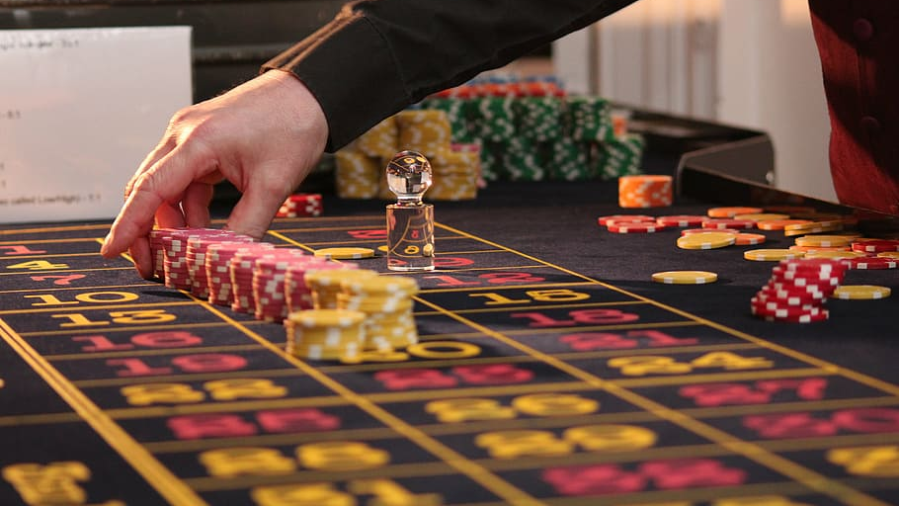
Additional Sponsors
Clegg’s Termite & Pest Control
Davidson, Holland, Whitesell & Co., PLLC
Morris Mechanical Incorporated
James Hoyle
Butler & Stowe
Spartan Tree & Landscape, Inc.
David & Lynette Demperio
David & Irene Norton
Linda Kocisak

Slide 8
Thank You Auction and Door Prize Donors
Amy McCarthy
Annie Earle
Charlotte Knights
Chase and Livi Carpenter
Cheddars
Daniel Stowe Botanical Garden
Facet Foundry Jewelry Studio
Freddie Ann Hutchens
Janet Layne
Joanne Mitchell
Mr. and Mrs. Michael Bradshaw
Nascar
Nothing Bundt Cake
Prolific Bodywork & Recovery
Publix
Sharp Business Systems
Tom Davis
Treescape
Watson Insurance
Webb Chemical
Webb Custom Kitchen
Whitewater Center
Wild Birds Unlimited

Slide 9

Gaston Residential Services, Inc.
Board of Directors
Rev. Paul Brintley – Chairman
Mr. Zed Bradley – Vice Chairman
Mr. Jim Hoyle – Secretary/ Treasurer
Ms. Alice Carpenter
Mr. Joe Grigg
Ms. Joanne Mitchell
Ms. Karen Morgan
Mr. John Russell
Ms. Selina Lee
Mr. Larry Capps
Mr. Jim Kellogg
Ms. Janet Layne

Slide 10


What Happens In Vegas, Stays In Vegas!
Visit
www.grsinc.org
for more information on Gaston Residential Services

Slide 11
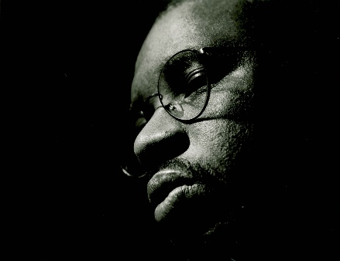
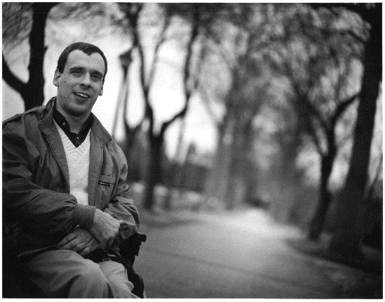
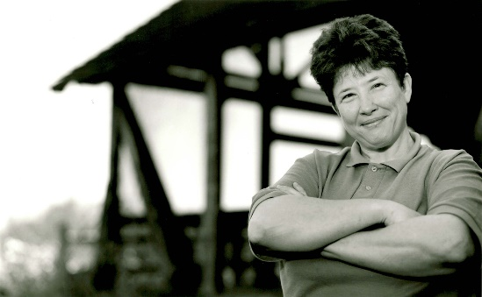
Gaston Residential Services
Making a Good Community Better
www.grsinc.org

